Slide 1
From Requirements to Architecture: Linguistics-based Specifications for the Software Startup
Sjaak Brinkkemper
with assistance from Garm Lucassen, Fabiano Dalpiaz, Jan Martijn van der Werf, Slinger Jansen, and Sean Martens
ICT-Entrepreneurship
Session 5
24 February 2020

Slide 2
Program of this Workshop
Rationale
Overview of the approach
W1 - Brainstorm
W2 - Jobs
W3 - Epic Stories
W4 - User Stories
W5 - Modules
W6 - Features
W7 – Reflection
Discussion

Slide 3
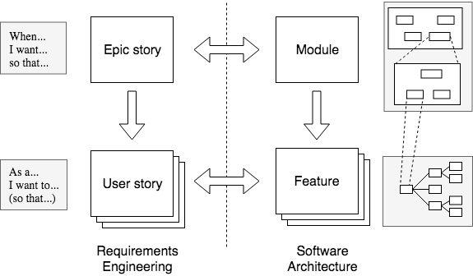
RE4SA-agile: bridging requirements and architecture
See: Spijkman, T., Molenaar, S., Dalpiaz, F., & Brinkkemper, S. (2021). Alignment and granularity of requirements and architecture in agile development: A functional perspective. Information and Software Technology, 106535.

Slide 4
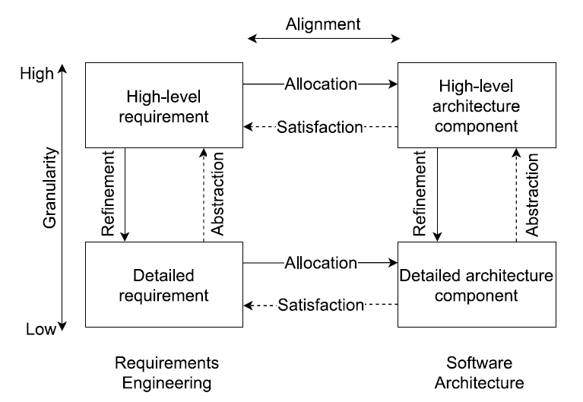
RE4SA generic model
Apply your own preferred notations

Slide 5
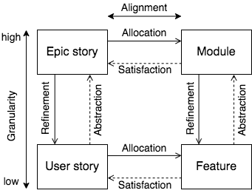
RE4SA: alignment and granularity
Granularity: the extent to which a system is composed of distinguishable pieces.
Granularity can be expressed in levels of decomposition.
It can either refer to the extent to which a larger entity is subdivided, or the extent to which groups of smaller indistinguishable entities have joined together to become larger distinguishable entities
Refinement: High-level requirements and architecture components are decomposed into detailed requirements and architecture components, respectively
Abstraction: Detailed requirements are grouped using high-level requirements, while detailed architecture components are bundled together based on similar functionality and placed in high-level architecture

Slide 6
RE4SA: alignment and granularity
Allocation: Relating requirements to architectural components is the assignment to architecture components responsible for satisfying the requirements
Satisfaction: Analyzing and elaborating the requirements demands that the architecture/design components that will be responsible for satisfying the requirements be identified
Alignment between requirements and architecture is a state in which the requirements specification is in harmony with the architectural specification and both describe the same application.
Perfect alignment between requirements and functional architecture is a state in which all the system requirements are satisfied by a component in the architecture, and all components in the architecture can
be linked to the requirements.

Slide 7
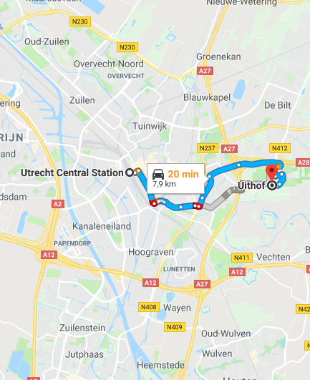
Job to be done
Requirements engineering
Software (architecture)
Application: Maps
A Job to be done is the process a consumer goes through whenever aiming to transform the existing life-situation into a preferred one, but cannot because there are constraints. (Klement, 2016)
Template:
Help me <verb> <noun phrase>
Google-maps:
“Help me plan a route to my destination.”

Slide 8
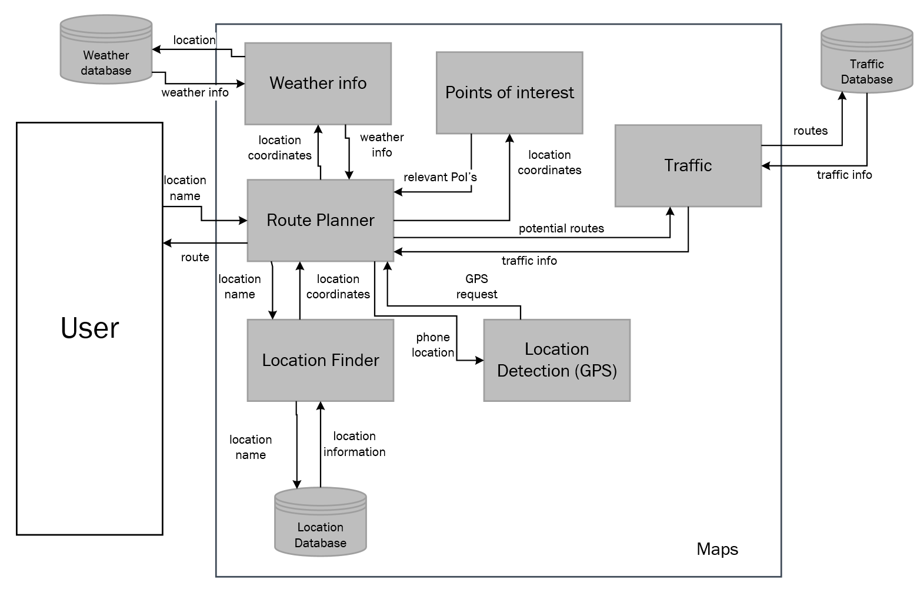
Epic story
Requirements engineering
Software architecture Module
Weather data provider
Traffic data provider
Epic stories emphasize the motivational and situational context that drives customer behaviour. (Klement, 2013)
Template:
When <situation>, I want <motivation>, so that <expected outcome>
“When I have to go to a place I don’t know, I want to have a route planned for me, so that I can plan my trip and find the location.”
My GPS Location
Functional Architecture Diagram

Slide 9
User story
Requirements engineering
Software architecture Feature
User stories represent customer requirements in a card, leading to conversation and confirmation (Jeffries, 2001)
Template:
As a <role>,
I want <goal>, so that <benefit>
“As a consultant,
I want to see the fastest route to my destination, so that I can minimize my travel time when visiting customers”
Set car mode
Route Planner
Set travel mode
Use public trans
Determine route
Determine route
Display routes
Get traffic impact
Generate directions
Feature Diagram

Slide 10
Epic story
Requirements engineering
Software architecture Module
Weather data provider
Traffic data provider
Product extension with a new Epic Story:
“When I have to file for expenses to my employer,
I want to have all my routes and local expenses registered,
so that I can collect my expense data and minimize effort for filing.”
Expense Filing
My GPS Location
Functional Architecture Diagram

Slide 11
User story
Requirements engineering
Software architecture Feature
User stories represent customer requirements in a card, leading to conversation and confirmation (Jeffries, 2001)
New User story
“As a consultant,
I want to file my travel expenses,
so that I have complete expense and travel data with minimal effort.”
Feature Diagram
Set car mode
Route Planner
Set travel mode
Use public trans
Determine route
Determine route
Display routes
Get traffic impact
Generate directions
File routes
Expense Filing
Register expense
Calculate expens
Collect expenses
Collect travel routes

Slide 12

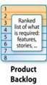
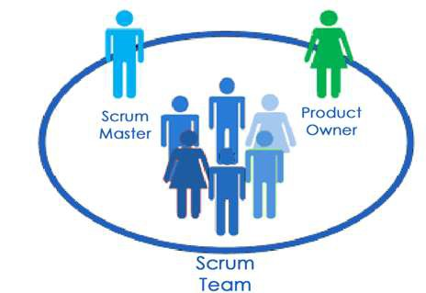




Agile perspective of software production
Market
Product

Slide 13







Continuous Delivery overview
Market
Product
Continuous Tracking
Continuous Planning
Continuous Integration
Continuous Testing
Continuous Deployment

Slide 14
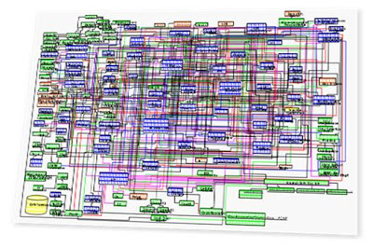
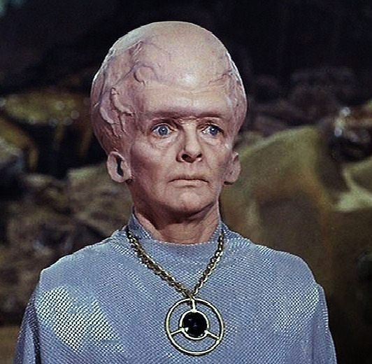
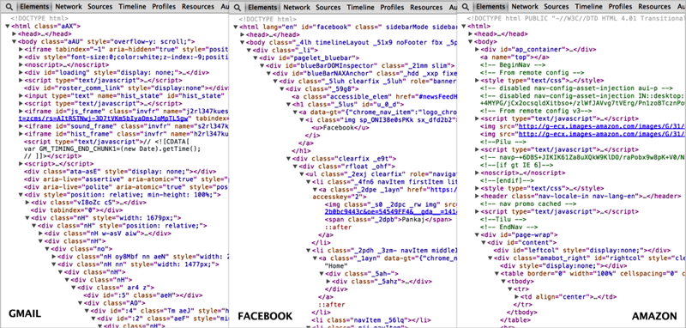
Key role: Software developers
Will software developers need Talosian brains?

Slide 15
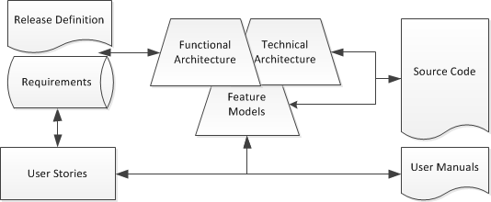
Development Domains
Requirements Management
Software Architecture
Software Engineering

Slide 16
Artefact Integration using NLP

Slide 17
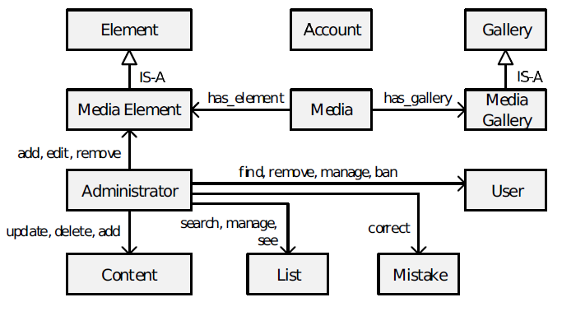
Artefacts and Domain Knowledge
User story:
As a Media User
I want to edit earlier uploaded video’s
So that my video contents stay up-to-date
Backlog item:
Sp-2-32: Cutting video segments
Sp-3-21: Inserting video segments
Sp-3-22: Publish new video after edit
Conceptual model
@feature(VideoEditing)
Public class VideoEditor {
// Sp-3-21 & 22 …
void CutSegment(String _videoTitle, ….)
void Publish(String _videoTitle)
. . . .
}
BDD: Gherkin template
Given I have finished editing
When I publish the updated video
Then the updated video appears in my video list
Feature Description
The system supports editing of video contents uploaded earlier with …
User manual
…..
Publishing When you have finished editing the video segment, click on the Publish button and the video will appear in your listing of video’s
….
Publish

Slide 18
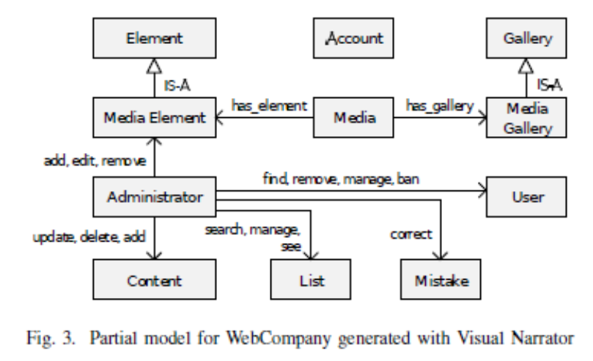
Conceptual models
Feature tracing

Slide 19
Impact forecasting

Slide 20
User Story to Acceptance Tests

Slide 21
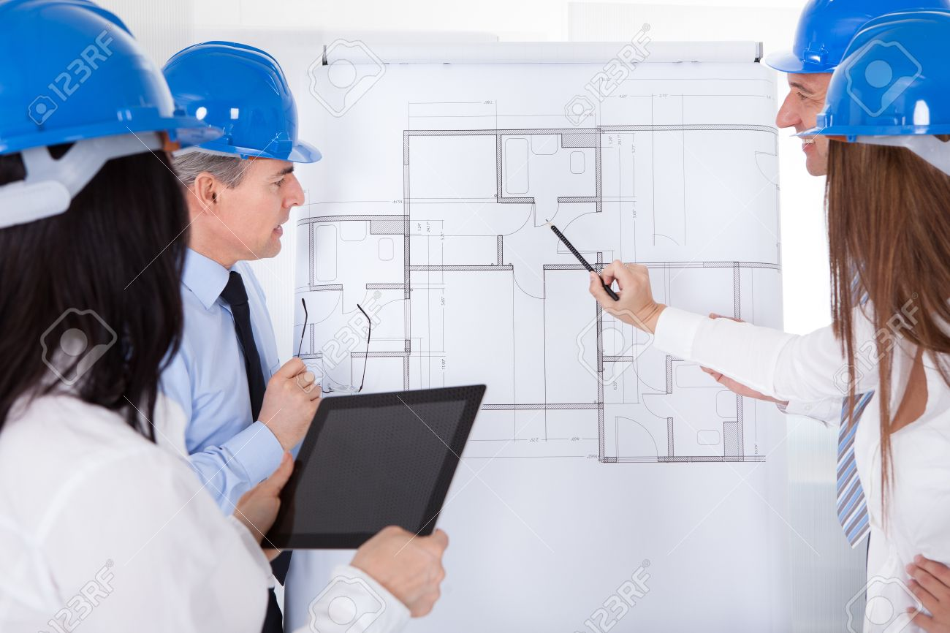
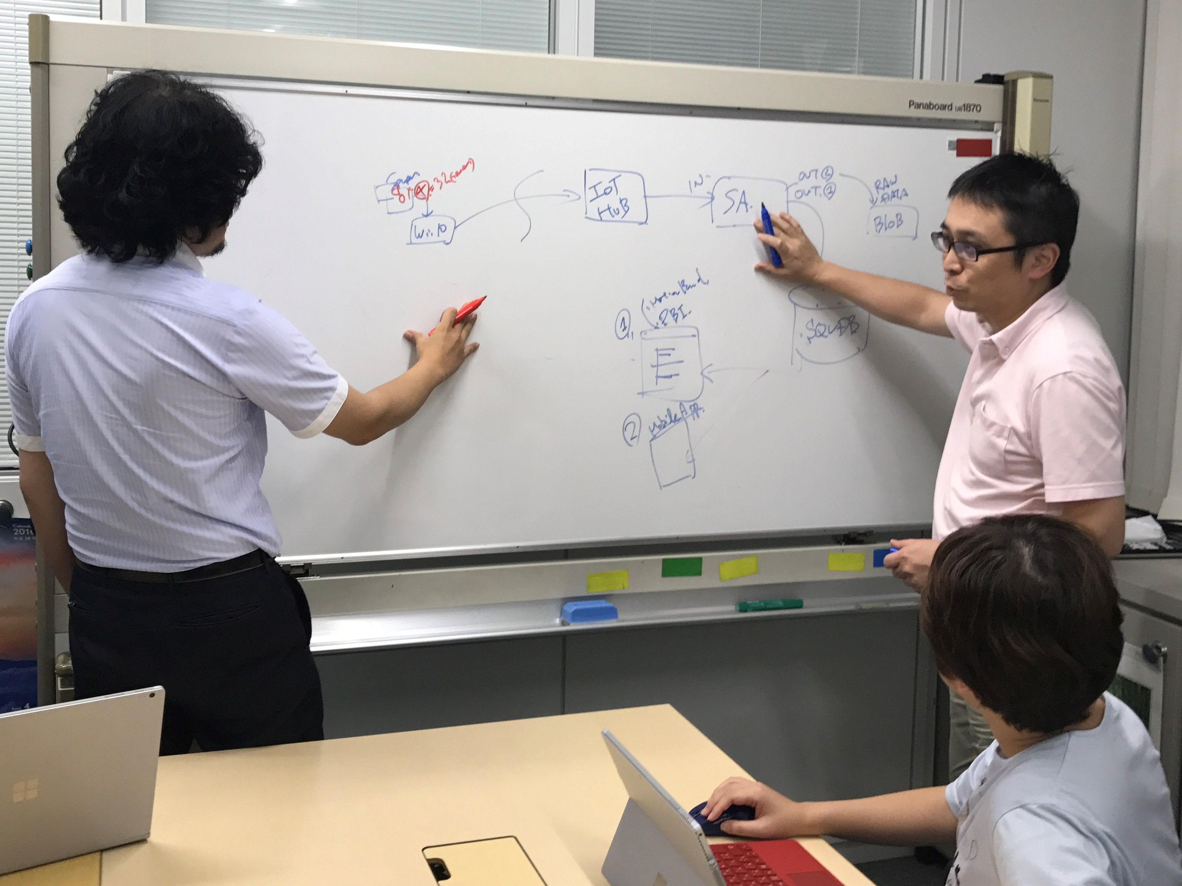
Architecting: find the 7 differences

Slide 22

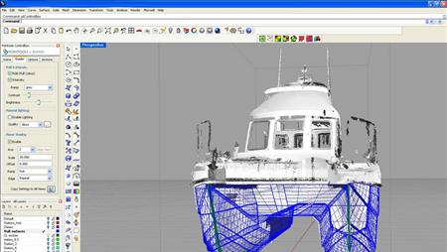
Observations in architecting
Traditional architecting disciplines have extensive documentation routines and practices
Architecture documentation is created during design and modified during redesign
When contemplating (re)design issues the architecture documentation is the central means for communication

Slide 23
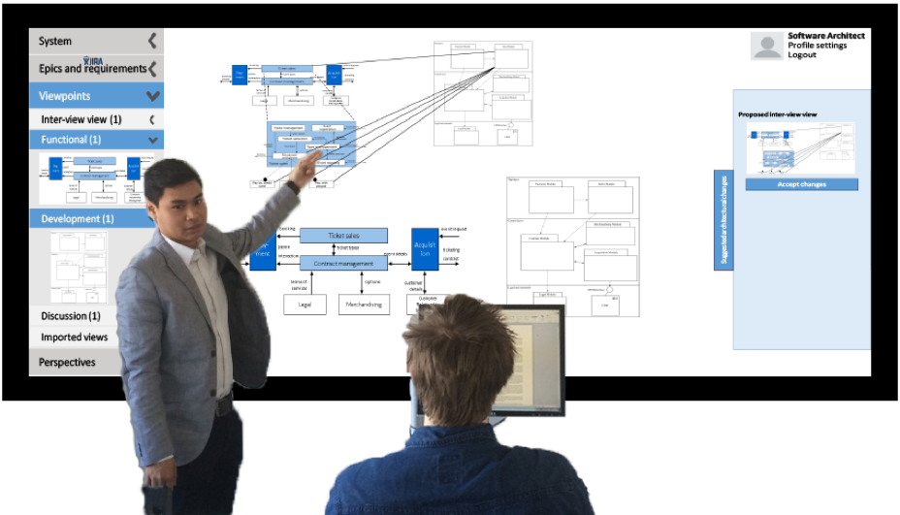
Software Architecture Video Wall

Slide 24
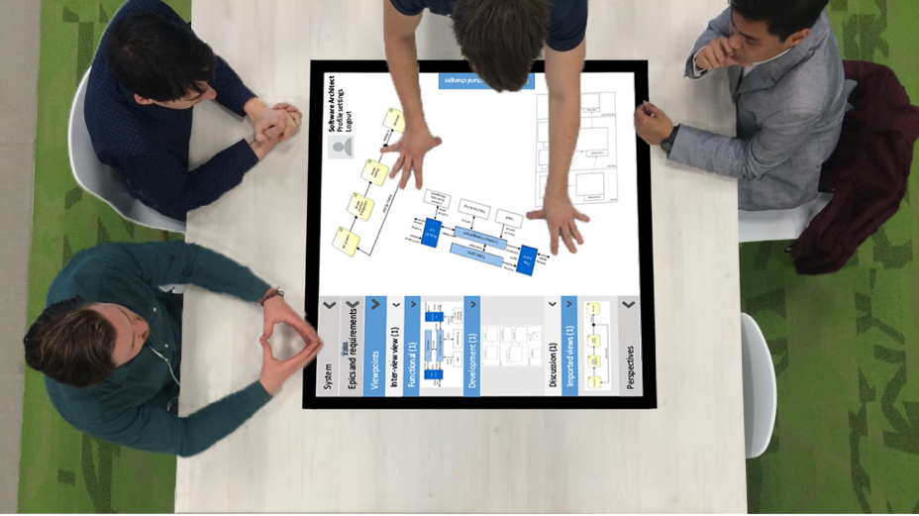
Video wall to capture design session
Record:
Screenplay
Audio track per participant
Text and argumentation mining
Extract key elements in discussion
Together with the screen shown at that time

Slide 25
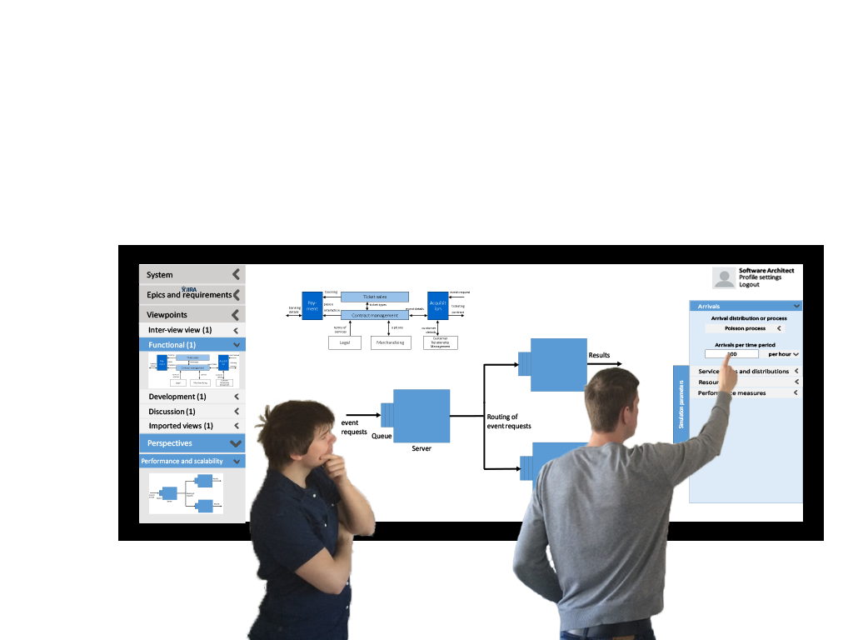
Behavior simulation

Slide 26
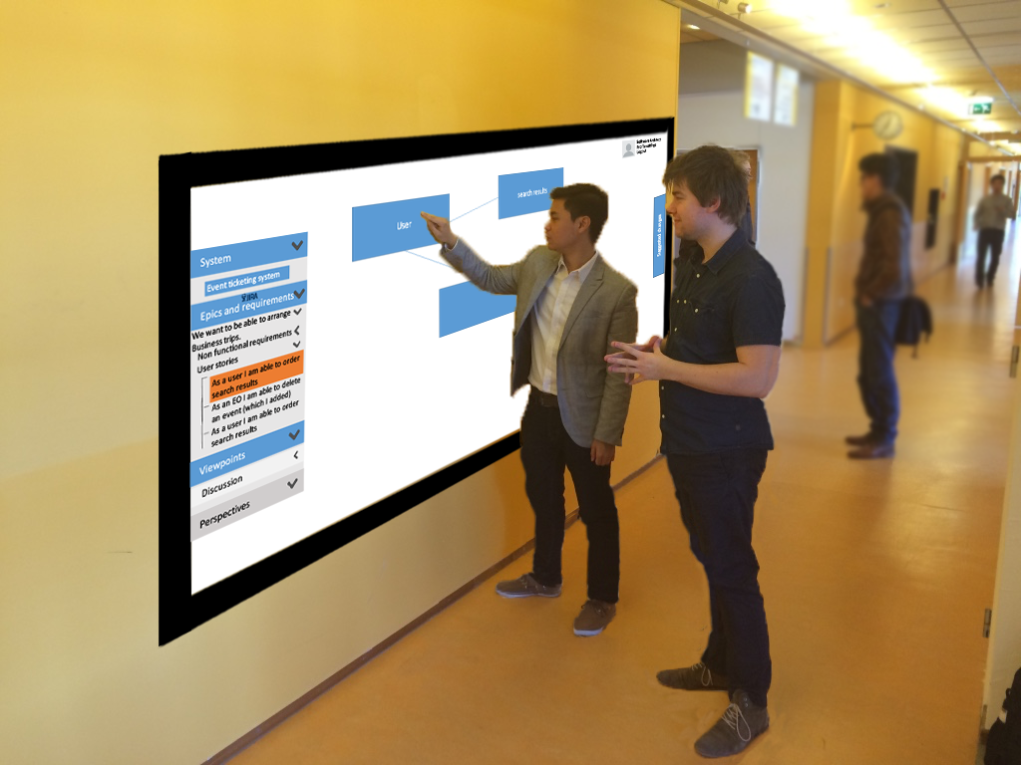
Hallway discussions

Slide 27
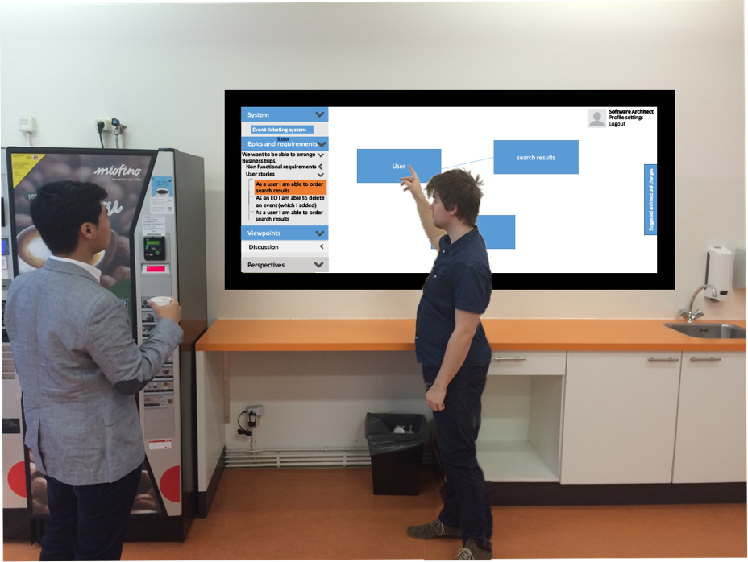
Informal options discussion at the Coffee corner

Slide 28
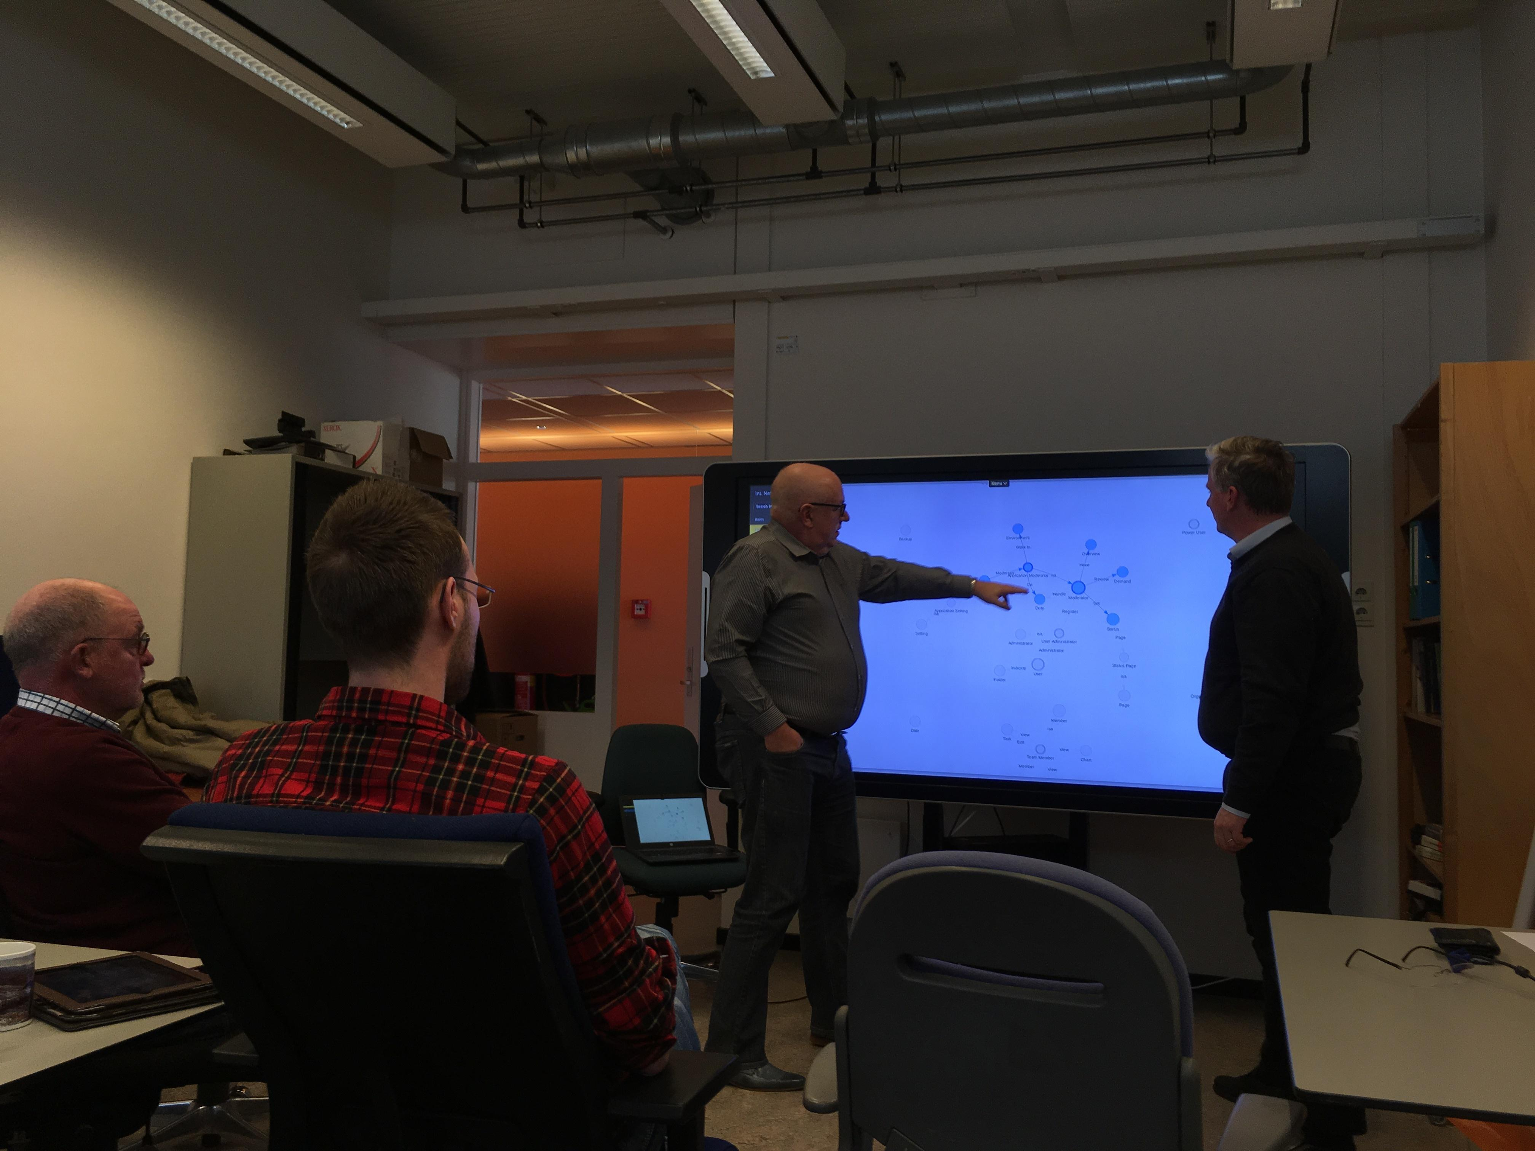
Team discussions

Slide 29
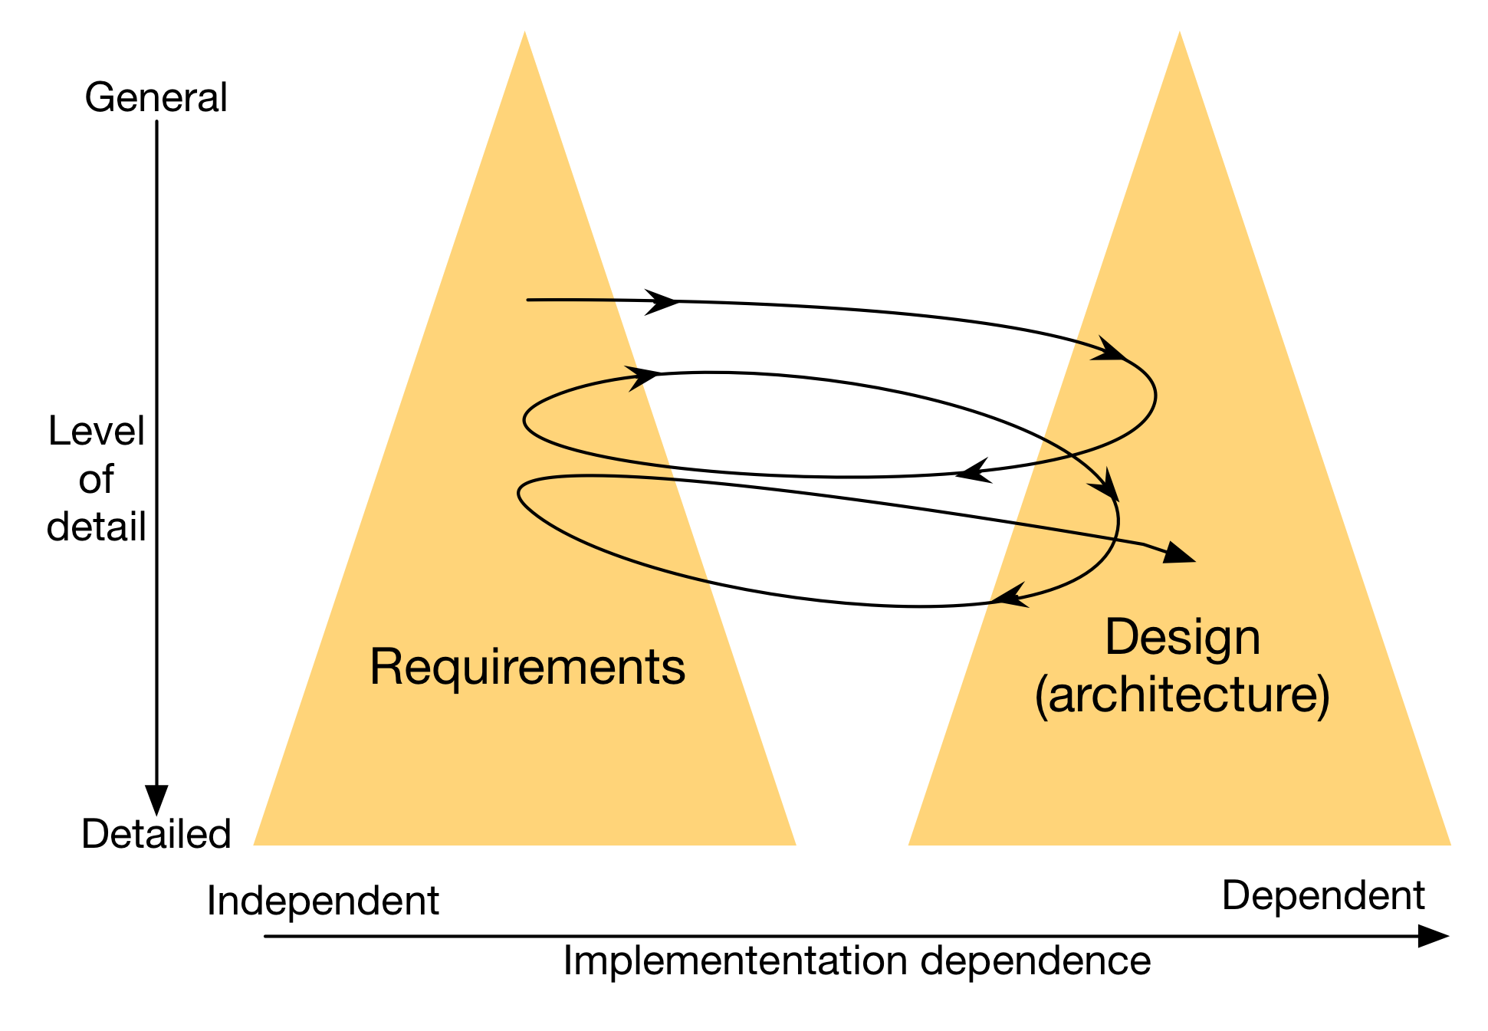
RE and SA processes
SPM is closely linked to requirements engineering (Ebert, 2007)
SA demands good requirements engineering
Twin Peaks of Requirements and Architecture (Nuseibeh, 2001)

Slide 30
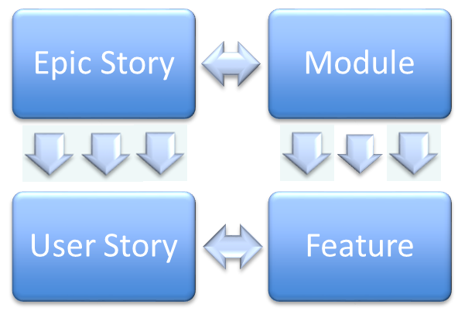
The RE4SA model
Requirements Engineering
Software Architecture

Slide 31
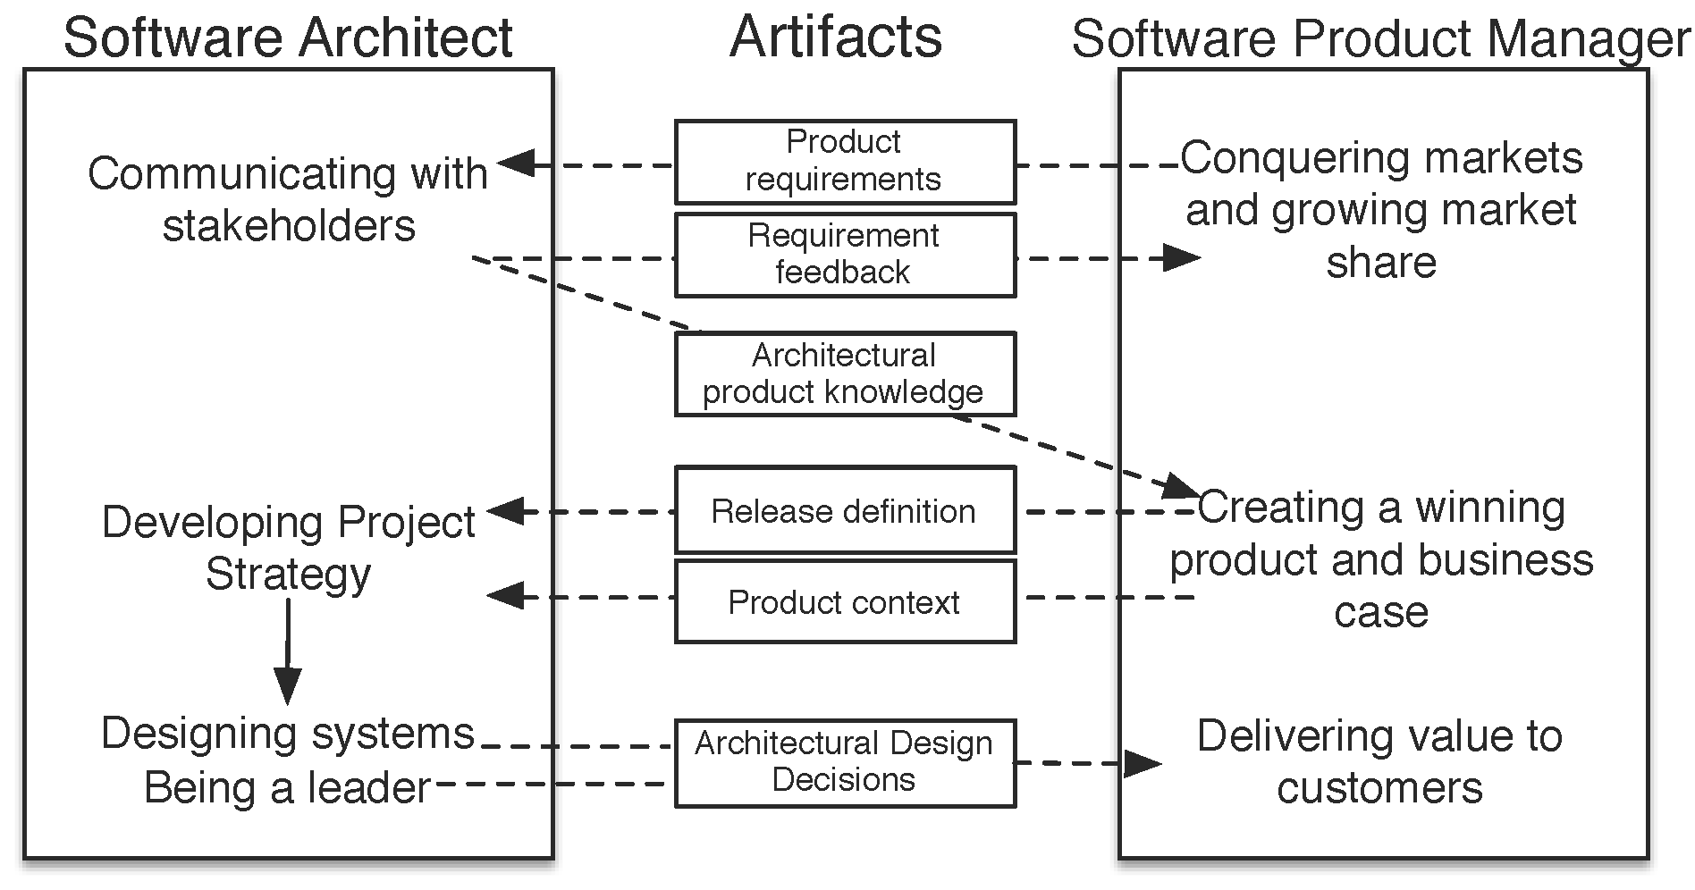
Reciprocal Contributions Model

Slide 32
Research project
Main research question:
`What is the value of Job Stories and Jobs-to-be-Done in the context of requirements engineering for software products?’
Exploratory study:
What is this new technique exactly?
How does it relate to existing techniques used in the software industry?
What is a method for its application in the context of software products?
Apply and evaluate the proposed method.

Slide 33
Take home message
Job Stories are an effective way to describe high-level product features and roadmap themes
The integrated method helps to implement job-stories in software companies
Job-stories should be used as a front-end to user story formulation and agile development

Slide 34
Program of this Workshop
Rationale
Overview of the approach
W1 - Brainstorm
W2 - Jobs
W3 - Epic Stories
W4 - User Stories
W5 - Modules
W6 - Features
W7 – Reflection
Discussion

Slide 35
Brainstorming on your product
You and your team have zillions of ideas?!
Functional on the market and customers.
Technical on the software technologies you master, or which you would like to use.
Organizational on the start-up you would like to start.

Slide 36
W1 – Brainstorm (15 mins.)
Exercise: Just write down any idea you have on the specifications of the product:
Requirements and Functional domains
Different roles
Features
Technology
User stories
Etc, etc.
Only functional and technical ideas, please. Others follow in other lectures.
Create a google slide set you share with SjaakBrinkkemper@gmail.com
Note, that you can write concurrently with your team!

Slide 37
Program of this Workshop
Rationale
Overview of the approach
W1 - Brainstorm
W2 - Jobs
W3 - Epic Stories
W4 - User Stories
W5 - Modules
W6 - Features
W7 – Reflection
Discussion

Slide 38
What are Jobs-to-be-Done?
Dr. Clayton Christensen: Disruptive Innovation Theory
“When people find themselves needing to get a job done, they essentially hire products to do that job for them”
Jobs-to-be-Done is a collection of principles that helps to discover and understand interactions between customers, their motivations and the products they use. (2016)
Job is shorthand for Job-to-be-Done
Template: “Help me <verb> <noun phrase>.”
Example: “Help me organize events”

Slide 39

The ‘Job’ of an early morning milkshake
Job: Help me stave of hunger until lunch.

Slide 40
Jobs – Event ticketing case
Job-1: Help me organize a multi-podium event with an attractive line-up of artists.
Job-2: Help me arrange secure payments for the visitors of my event
Job-3: Help me organize a variety of event types
Job-4: Help me build a community of visitors of my events
Open research question: Should we distinguish primary jobs and secondary jobs?
Primary Job: Help me organize a variety of event types
Secondary Job: Help me build a community of visitors of my events
The secondary job is part of the primary job.

Slide 41
W2 - Jobs
Exercise: Identify and write some Jobs for your product idea.
We expect 3 to 5 per product.
You can make a sequential order for the jobs of the first release (Minimal viable product) and the later releases.
Use the template.
Job-1: Help me organize a multi-podium event with an attractive line-up of artists.

Slide 42
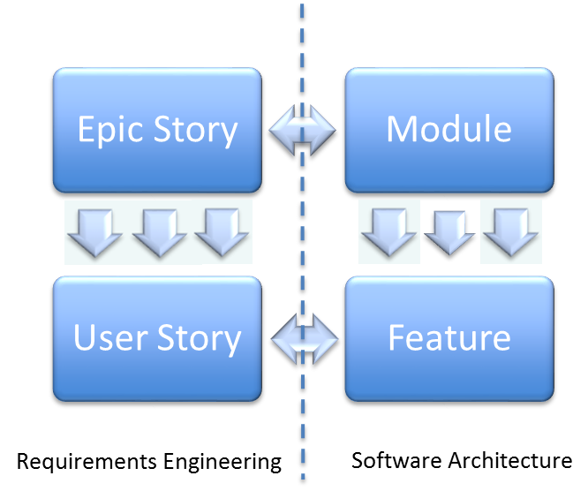
Program of this Workshop
Rationale
Overview of the approach
W1 - Brainstorm
W2 - Jobs
W3 - Epic Stories
W4 - User Stories
W5 - Modules
W6 - Features
W7 – Reflection
Discussion

Slide 43
Epic Stories
2013: Alan Klement introduced the template for Epic Stories as an alternative or replacement to User Stories.
When [situation], I want (to) [motivation], so that (I can) [expected outcome]
Emphasize the motivational and situational context that drives customer behavior.
“When I am configuring a radiator and I am trying to produce a specific amount of heating power, I want to quickly determine what configuration of radiators will produce the required heat, so that I won’t have to waste time looking for the optimal configuration.”
Klement introduced the template as Job Story, however due to the existing notion of epics in Scrum development, we renamed it into Epic Story.

Slide 44
Conceptualization of Epic Stories
Small community of practice in Epic Stories
Klement template: When … I want to … so that … .
Research project of UU at Stabiplan (Maxim van der Keuken)
Identified 131 Epic Stories in public domain; 113 according to template
Created Conceptual Model of Epic Stories
When <problematic situation> I want to <motivation> so that <expected outcome>
Problematic situations & Expected outcome are either:
Action, State, or External Events
Varying statistics on the 113 JSs. (topic for further research)

Slide 45
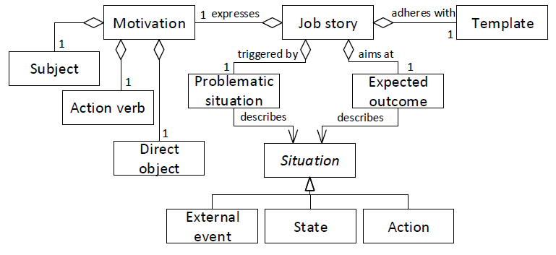
Conceptual model of Epic Stories

Slide 46
Epic Stories – Event ticketing case
Job-1: Help me organize a multi-podium event with an attractive line-up of artists.
Epic:
“When I am organizing a multi-podium event and I am contracting artists to configure the line-up, I want to keep a good overview of the artist configuration on the podiums, so that I can see the options for an optimal experience of the event visitors”
Job-2: Help me arrange secure payments for the visitors of my event
Epic:
“When I am organizing any type of event, I want to my prospective visitors to have an adequate number of secure payment options, so that I have no problems with fraud and cumbersome customer services.”

Slide 47
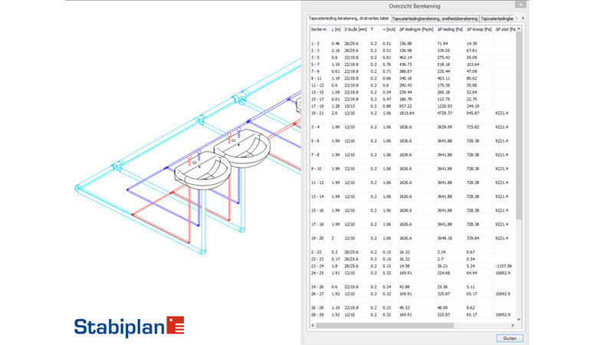
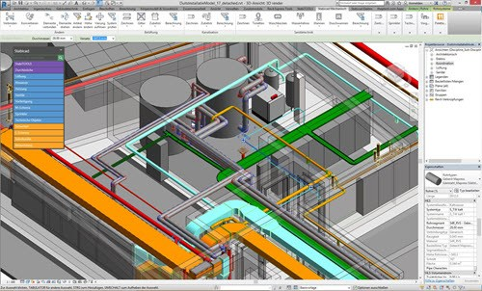
Case Study: Stabiplan (ModelComp)
Computer Aided Design (CAD) software for the modeling installations for mechanics, electronics and plumbing (MEP).
Expands Autodesk AutoCAD and Revit products.
170 employees (65 in R&D)
3800 customers

Slide 48
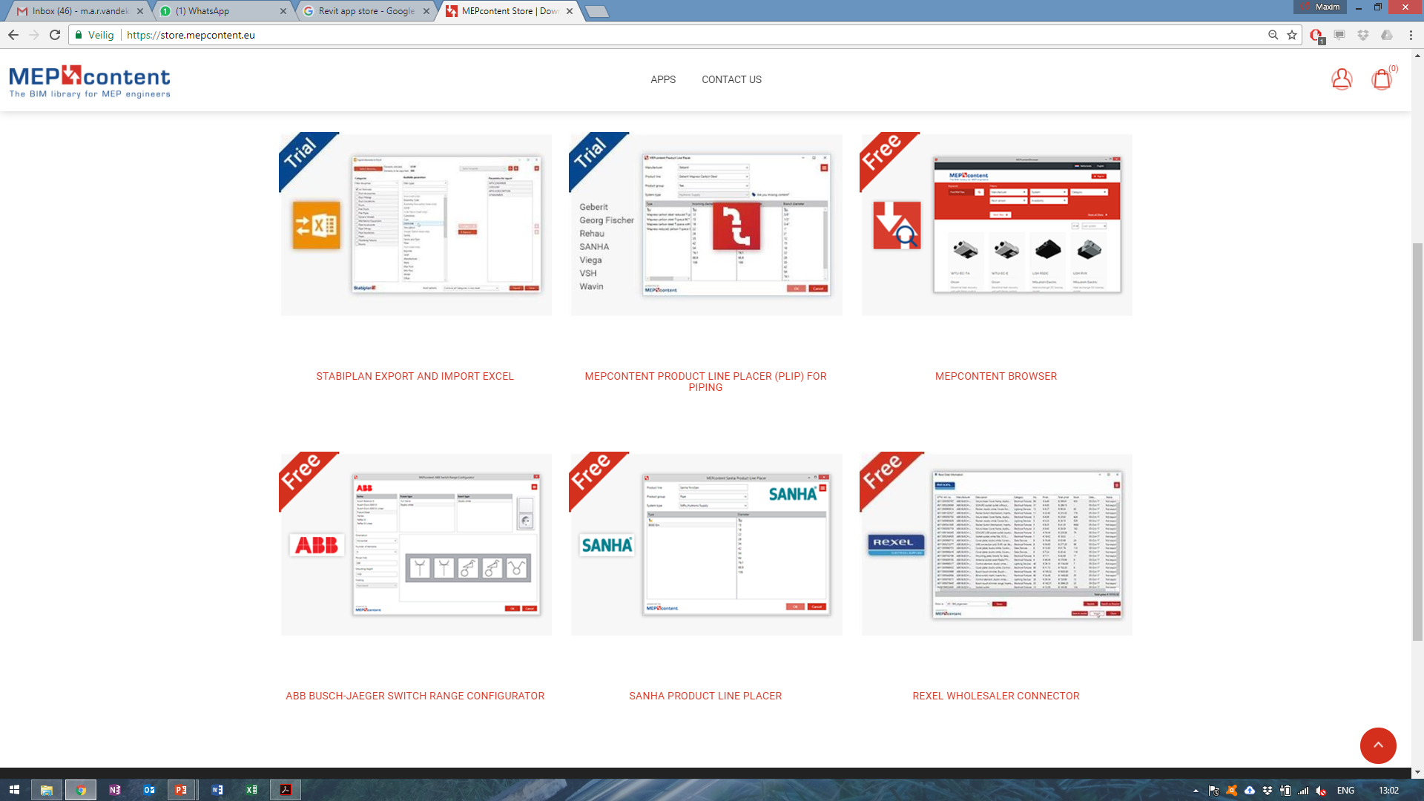

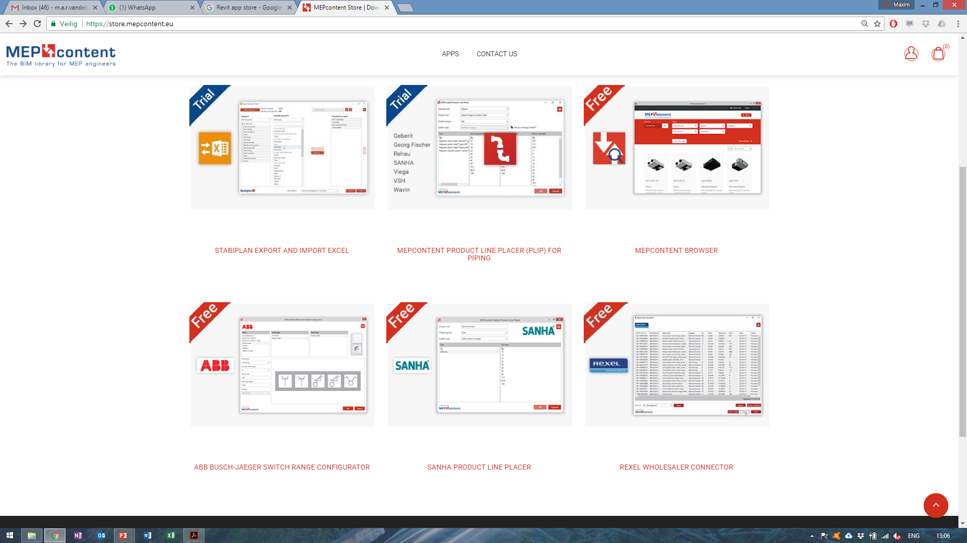
Case Study: Stabiplan
StabiCad: Large monolithic desktop product
Company strategic goal: Expand to the global market via a portfolio of apps.
Independent products with limited functionality.
`What functionality should be included in the apps to incite users to adopt it?’
The apps should address customers’ Jobs-to-be-Done?
Focus on app related to radiators

Slide 49
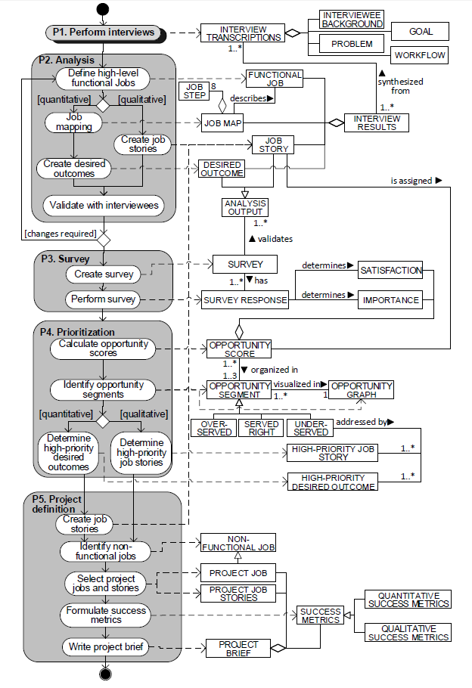
Integrated Epic Story method
Combination of existing approaches, used to define high-level requirements for a development project.
Five phases:
P.1 Interview phase
P2. Analysis phase
P3. Survey phase
P4. Prioritization phase
P5. Project definition phase

Slide 50
W3 – Epic stories
Exercise: Identify and write some Epic Stories for your product idea, based on the Jobs you created in W2.
We expect 3 to 5 per Job.
You do not have to do this for all Jobs. Restrict yourselves to the most prominent ones.
Use the template.
When [situation], I want (to) [motivation], so that (I can) [expected outcome]
“When I am organizing a multi-podium event and I am contracting artists to configure the line-up, I want to keep a good overview of the artist configuration on the podiums, so that I can see the options for an optimal experience of the event visitors”

Slide 51
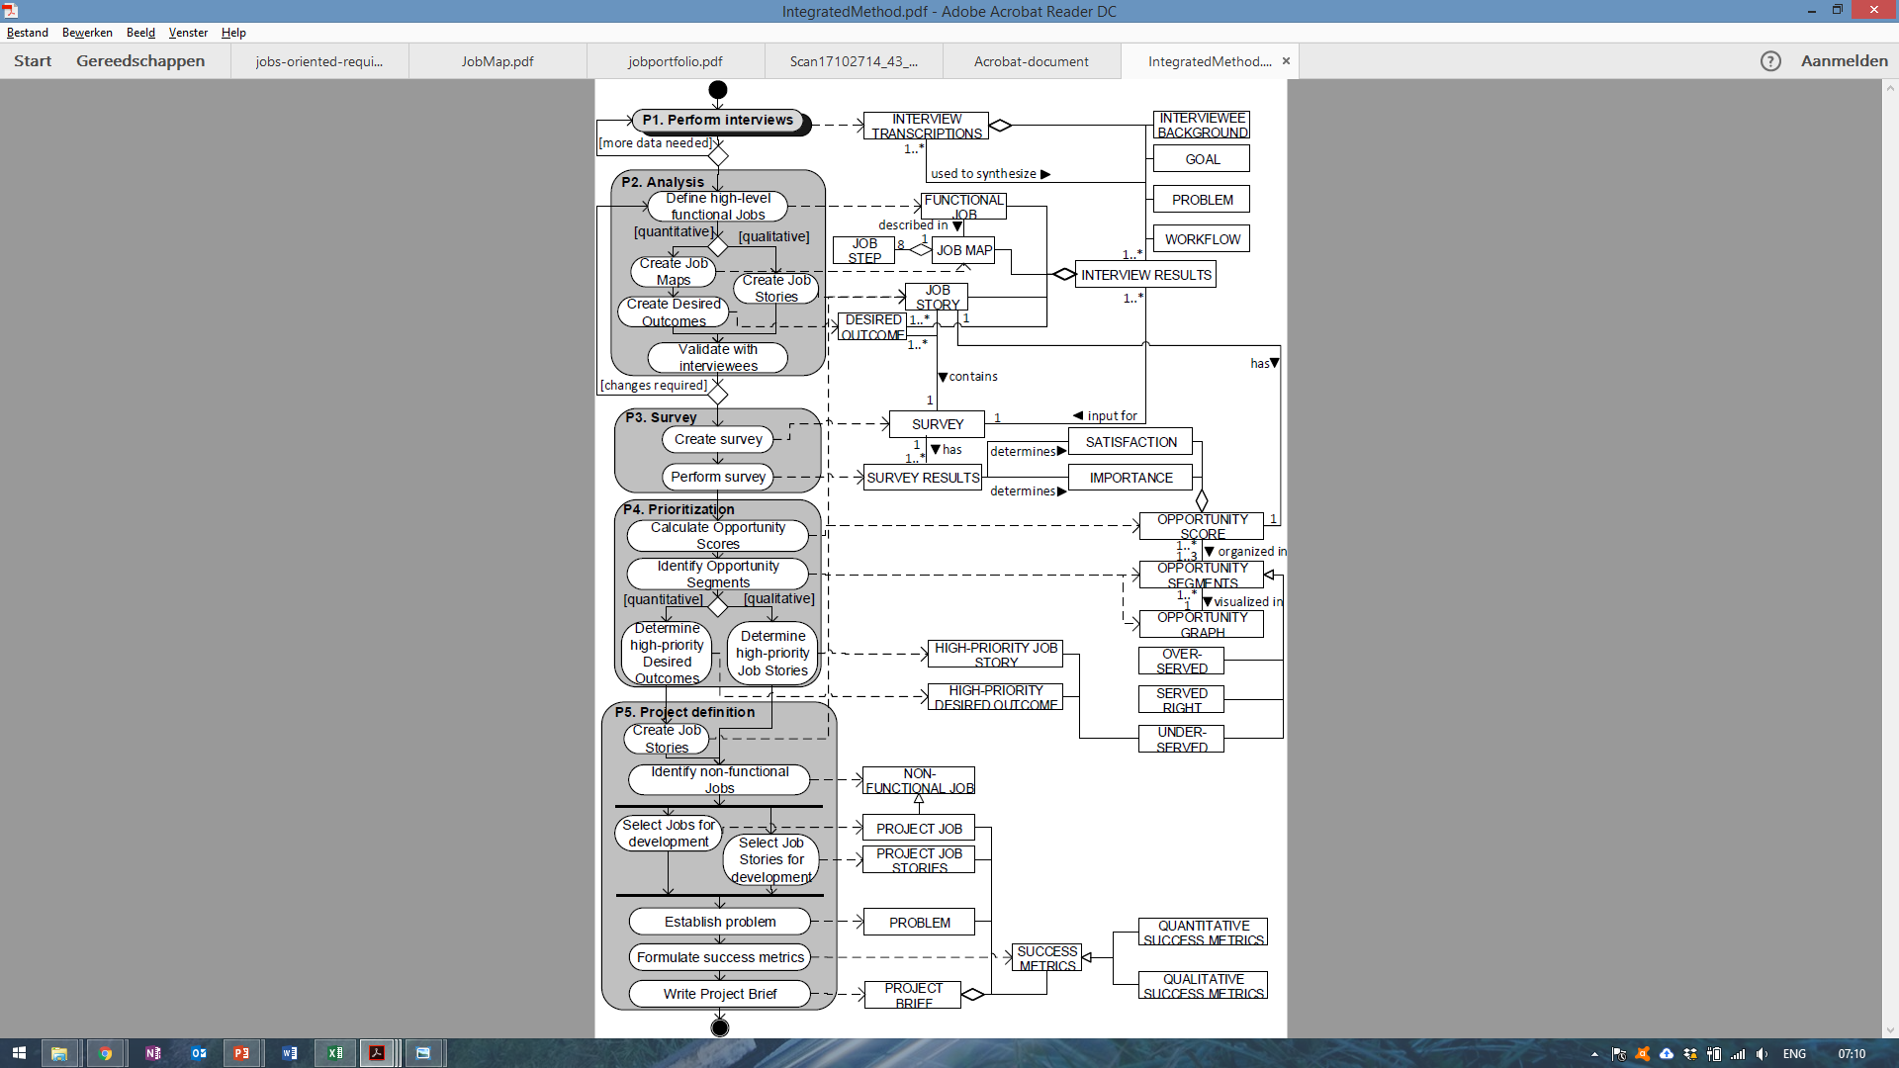
P2. Analysis phase: Analyze the workflow, context and motivations of the interviewees to formulate initial Jobs and Job Stories.
Case:
In the interviewees’ workflow we identified four functional Jobs:
J1: Help me configure radiators
J2: Help me place radiators
J3: Help me model piping systems
J4: Help me create bills of materials
Help me model piping systems
We created Job Stories that highlight different parts of each Job, based on contextual information obtained in the interviews.
When [situation], I want (to) [motivation], so that (I can) [expected outcome]

Slide 52
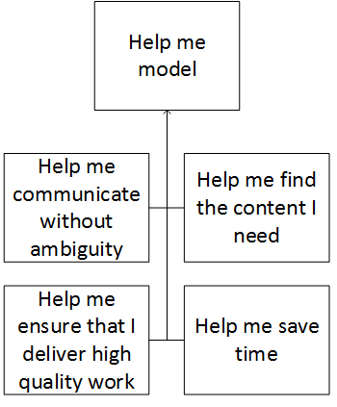
P5. Project definition phase Select the Jobs and Job Stories for development, and create a project brief that can facilitate the follow-up development project.
Case: To help define concrete apps based on the high priority Job Stories, we re-categorized the Job Stories based on non-functional Jobs, instead of functional Jobs.
Why?
By getting a functional task done, a customer is looking to achieve a “deeper” benefit → non-functional Jobs!
Research issue: Is it good practice to distinguish functional and quality jobs?

Slide 53
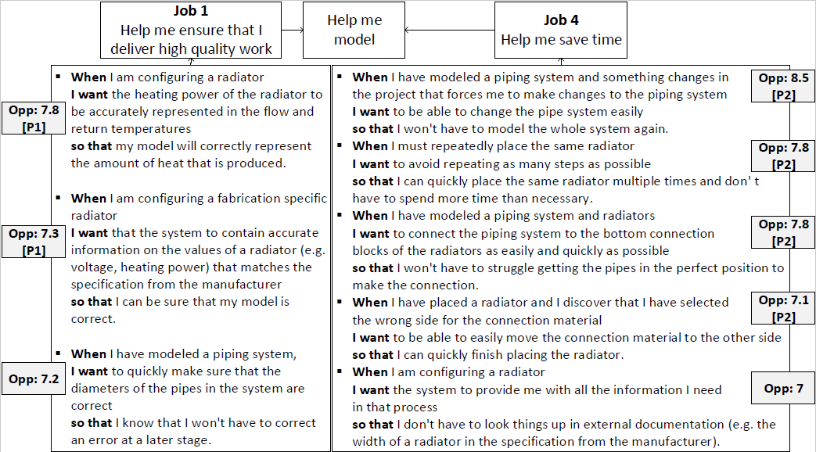
P5. Project definition phase Select the Jobs and Job Stories for development, and create a project brief that can facilitate the follow-up development project.
Case: We selected two non-functional Jobs to each address with an app, based on the number of related high-priority Job Stories.
We defined the scope of the apps based on concrete problems that relate to the Job.
P1: Ensuring correct parametrical information.
P2: Changing existing piping systems.

Slide 54
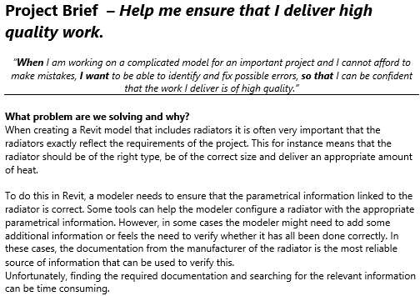
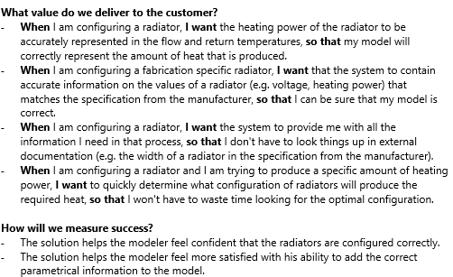
P5. Project definition phase Select the Jobs and corresponding Epic Stories for development, and create a project brief that can facilitate the follow-up development project.
Case: We created a Project Brief for each Job, to serve as input for the design process.
Single page document, used as a basis for design and development (Intercom).
Creates a shared understanding of the problem among different stakeholders.

Slide 55
Program of this Workshop
Rationale
Overview of the approach
W1 - Brainstorm
W2 - Jobs
W3 - Epic Stories
W4 - User Stories
W5 - Modules
W6 - Features
W7 – Reflection
Discussion

Slide 56
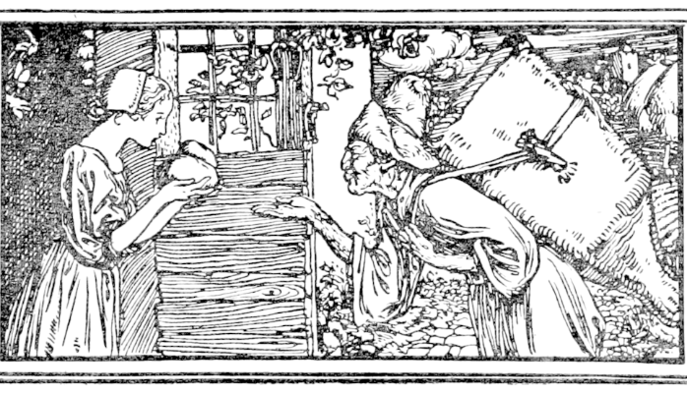
User stories the GRIMM project
This part is based on the PhD dissertation research of Garm Lucassen

Slide 57
What is a user story?
“As a Visitor, I want to purchase an event ticket”
“As a visitor, I want to search for new events by favorited organizers so that I am the first to know of new events”
“As a Visitor, I want to be notified when an event is close to becoming sold out, so that I do not miss the event”

Slide 58
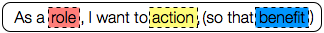
What is a user story?
User stories represent customer requirements in a card, leading to conversation and confirmation (Jeffries, 2001)
User stories only capture the essential elements of a requirement: - who it is for - what it expects from the system - why it is important (optional?)
Simple format used by 70% of practitioners
(Lucassen et al., 2016)
(Connextra)

Slide 59
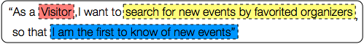
What is a user story?
“As a Visitor, I want to purchase an event ticket”
“As a visitor, I want to search for new events by favorited organizers so that I am the first to know of new events”
“As a Visitor, I want to be notified when an event is close to becoming sold out, so that I do not miss the event”

Slide 60

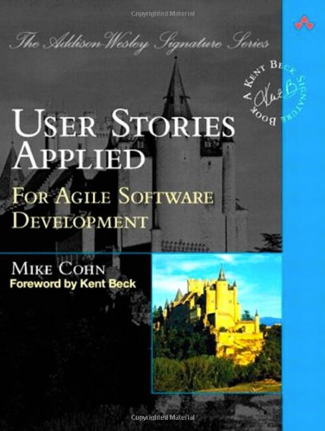
History
First mention in Kent Beck’s 1999 book Extreme Programming Explained
Unstructured text
Similar to use cases
Restricted in size
Jeffries 2001: card, conversation, confirmation
Widespread popularity after Mike Cohn’s User Stories Applied in 2004
Notes:
Say something about focus on customer in business language, not on technical jargon, technical details or UI concerns. User stories should be negotiable.

Slide 61
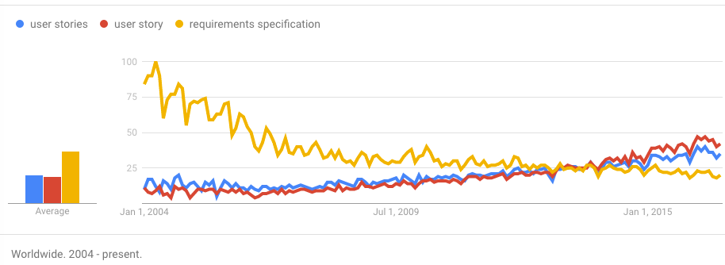
Popularity
45% of practitioners employ user stories (Kassab, 2015)
In agile: 90%! (Wang, 2015)

Slide 62
Industry survey
Survey w/182 responses & 21 follow-up interviews
Use of user stories
Development Methods
Templates
Perception of user story effectiveness
Impact on productivity?
Impact on work deliverable quality?
(Lucassen et al. 2016a)
http://bit.ly/us_effective
Notes:
To gain a deeper understanding of the phenomenon user stories, we conducted a short survey with 21 follow-up interviews. In this presentation I want to share the results with you regarding practitioner’s use of user stories and their perception of user stories’ effectiveness.
In particular, we’ll look at the impact on perceived productivity and perceived work deliverable quality.

Slide 63
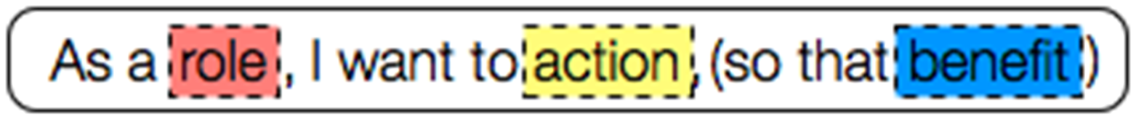
Conceptual model and User story quality framework
Lucassen, G., Dalpiaz, F., van der Werf, J. M. E., & Brinkkemper, S. (2016b) Improving agile requirements: the Quality User Story framework and tool. Requirements Engineering Journal, 1-21.
http://bit.ly/improving_us

Slide 64
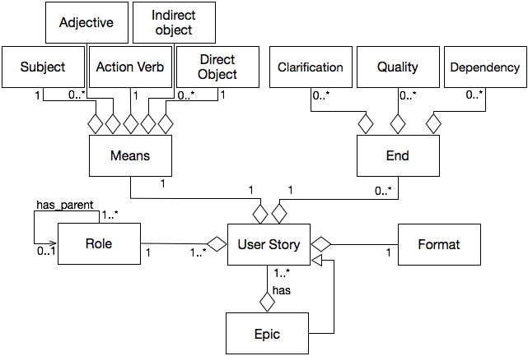
Conceptual model

Slide 65
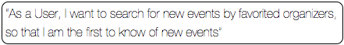
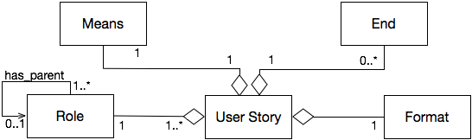
Conceptual model

Slide 66
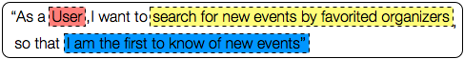
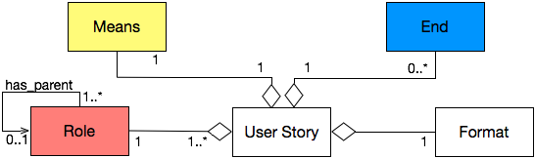
Conceptual model

Slide 67
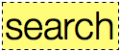


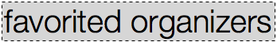






Means concepts

Slide 68






Ends concepts

Slide 69
Conceptual model

Slide 70

Google language tooling

Slide 71
Larger sentences

Slide 72

Ontology tooling

Slide 73
Quality problems in practice
Model captures correct stories
Stories from practitioners:
Too long
Unnecessary information
Too little information
Inconsistent
Irrelevant
Ambiguous

Slide 74
Going from…
“As a Visitor, I want to buy an event ticket”
“As a Visitor, I want to be notified when an event is close to becoming sold out, so that I do not miss the event”

Slide 75


Slide 76
W4 – User stories
Exercise: Identify and write some User Stories for your product idea, based on the Jobs and Epic Stories you created in W2 and W3.
We expect 3 to 5 per Epic Story for this workshop. Later about 20-30 can be the refinement of an Epic Story.
You do not have to do this for all Jobs and Epic Stories. Restrict yourselves to the most prominent ones.
Use the template.
“As a <role>, I want <action>, so that <benefit>”
“As a Visitor, I want to be notified when an event is close to becoming sold out, so that I do not miss the event”

Slide 77
Program of this Workshop
Rationale
Overview of the approach
W1 - Brainstorm
W2 - Jobs
W3 - Epic Stories
W4 - User Stories
W5 - Modules
W6 - Features
W7 – Reflection
Discussion

Slide 78
Functional Architectures
A functional view is an architectural model from a usage perspective
So the functional architecture should resemble the enterprise functions of the customer organisation or user context
Names of modules should resemble the names of enterprise functions
Flows in functional architecture resemble the interactions in the customer domain
Standard functional architecture is called Reference Architecture

Slide 79
Functional Architecture for ERP product
Bussiness Planning
Product Innovation
BusinessPlan
Product Information
Master Planning
Sales Forecast
Master Plan
Sales Order Ready for Assembly
PO/ Contracts/ Inquiries
Material Plan
Customer Request
Pur-
chase
Requirements Planning
Assem-
bly
Sales
Subcontracting
Material Plan
Invoiced Sales Order
Production
Progress
Packing and shipping order
Production
Orders/ schedules
FAS Order
Warehousing
Received Goods
Picking List
Picking List
Shipment order
Receipt &
Goods
Component
Manufact.
Assembly
Packing &
Shipping

Slide 80
Usage of the Functional architecture
Structure for processes in Software Product Management: Functional Architecture Framework (FAF)?
Consider practical issues like:
How to manage the product vision for future, subsequent releases?
How to register incoming requirements from customers and prospects?
How to assign work to development teams?
How to manage large volumes of requirements in a distributed company?

Slide 81
Notation of FAs
Module or sub-module: business function consisting of a set of continuous processes
Color is used for categorization
All words start with Capital
Flow: transfer of data between modules
all lower case
Scenario: continuous process
as overlay on FA
Publishing
final document

Slide 82
Product: Functional architecture
On-line Event Ticketing
Module
booking
event request
Pay- ment
Ticket sales
Acqui- sition
payee interaction
ticket types
ticketing contract
banking details
event details
Contract management
terms of services
options
customer details
Product scope
Information flow

Slide 83
FA on module level: Ticket sales
Visitor management
Event registration
event details
visitor details
Ticket selection
templates
package structures
payment details
Type management
ticket types
final ticket
booking
Pre-payment arrangement
ticket overview
Event reporting
reports
Ticket sales
Module scope
Sub-module

Slide 84
FA of Contract management
final contract
Sub-module
Contract baseline
contract version
ticket types
event details
Event administration
payee interaction
terms of services
option details
options
Options handling
Contract management
Module scope

Slide 85

FA of Technical systems
FAs can also be provided for technical systems
Example:

Slide 86

W5 – Modules
Exercise: Identify and draw some Modules for your product idea, based on the Jobs, Epic Stories and User Stories you created in W2, W3, and W4.
We expect about 1 per Job for this workshop. What is the effect of primary and secondary Jobs
You do not have to do this for all Jobs and Epic Stories. Restrict yourselves to the most prominent ones.
Use the notational conventions.

Slide 87
Program of this Workshop
Rationale
Overview of the approach
W1 - Brainstorm
W2 - Jobs
W3 - Epic Stories
W4 - User Stories
W5 - Modules
W6 - Features
W7 – Reflection
Discussion

Slide 88
Functional Decomposition for Feature Identification
The modules in a functional architecture are modelled in 2 or 3 layers
At the lowest level the module consists of features
Definition: Feature is a discrete unit of unique and attractive functionality of a product that delivers measurable benefit to customers
The lowest level modules are elaborated in a feature model
M1
M2
M3
Mn
M11
M12
Mn1
Mn2
M13
Mn3
Mn4
F1
F2
F3
F4

Slide 89

Case: Event Ticketing
Select ticket
Edit event
Deselect ticket
Search event
Calculate total price
Combine events
Confirm tickets

Slide 90

Feature model diagram
Note: this feature model does not obey our naming conventions!

Slide 91
Naming conventions: Module
A Module in the Product perspective has the same name as an Enterprise function in the Reality perspective:
Definition: An enterprise function is a collection of coherent processes, continuously performed within an enterprise and supporting its mission
Examples: Corporate Planning, Human Resource Management, Supplier Contract Management, Shop Floor Control
Naming standards:
Nouns: Planning in stead of Plan
Precise, determining words known in the business domain
Name is Capitalized

Slide 92
Naming conventions: Feature
A Feature in the Product perspective has the same name as a process in the Reality perspective:
Definition: A process is an activity of which the execution can be described in terms of needed and delivered data and of which the start and end can be determined.”
A process is the WHAT a company does and not HOW it is being done.
Examples: Receive order, Register complaint, Print invoice, Select basic configuration
Naming standards:
Name starts with Verb, followed by a Noun phrase: Register complaint
Precise, determining words known in the business domain
Only Verb is Capitalized

Slide 93
W6 – Features
Exercise: Identify and write some Feature for your product idea, based on the Jobs, Epic Stories, User Stories, and Modules you created in W2 – W5.
We expect 1 or 2 per User Story for this workshop.
You do not have to do this for all Jobs and Epic Stories. Restrict yourselves to the most prominent ones.
Use the naming convention.

Slide 94
W7 – Reflection
Exercise: What did you think of this exercise in learning to specify your product.
Use the slide in your slide set.
Later on you will finalize this work in the Prototype and architecture assignment.

Slide 95
Current and future MSc and PhD projects
First exploratory studies, more work to be done.
Well-documented case studies are needed to get more insight in the value of Jobs-to-be-Done and Epic Stories.
Investigate the relation of Epic Stories/User Stories to Modules/Features, and how to integrate this RE4SA with existing agile approaches.
Extraction, transformation and traceability of concepts from artefacts utilizing natural language processing tools.

Slide 96
Questions and discussion contact: S.Brinkkemper@uu.nl

Slide 97
Literature
Jobs and Epic Stories
Garm Lucassen, Maxim van de Keuken, Fabiano Dalpiaz, Sjaak Brinkkemper, Gijs Willem Sloof, Johan Schlingmann: Jobs-to-be-Done Oriented Requirements Engineering: A Method for Defining Job Stories. REFSQ 2018: 227-243
Klement, A.: When Coffee and Kale Compete. NYC Publishing (2016)
Christensen, C. M. (2006). The ongoing process of building a theory of disruption. Journal of Product innovation management, 23(1), 39-55.
User Stories
Garm Lucassen, Marcel Robeer, Fabiano Dalpiaz, Jan Martijn E. M. van der Werf, Sjaak Brinkkemper: Extracting conceptual models from user stories with Visual Narrator. Requir. Eng. 22(3): 339-358 (2017)
Garm Lucassen, Fabiano Dalpiaz, Jan Martijn van der Werf, Sjaak Brinkkemper: Improving agile requirements: the Quality User Story framework and tool. Requirements Engineering, 15(1): 1-21 (2016)
Software Architecture
Garm Lucassen, Fabiano Dalpiaz, Jan Martijn van der Werf, Sjaak Brinkkemper: Bridging the Twin Peaks - The Case of the Software Industry. TwinPeaks@ICSE 2015: 24-28
Jan Martijn E. M. van der Werf, Rico de Feijter, Floris Bex, Sjaak Brinkkemper: Facilitating Collaborative Decision Making with the Software Architecture Video Wall. ICSA Workshops 2017: 137-140
Sjaak Brinkkemper, Stella Pachidi: Functional Architecture Modeling for the Software Product Industry. ECSA 2010: 198-213
Wilbert Seele, Shaheen Syed, Sjaak Brinkkemper: The Functional Architecture Modeling Method Applied on Web Browsers. WICSA 2014: 171-174
Tomas Salfischberger, Inge van de Weerd, Sjaak Brinkkemper: The Functional Architecture Framework for organizing high volume requirements management. IWSPM 2011: 17-25

